Slide 1

Hack Night: October 17th @ 5:00 PM Student Innovation Centre

Slide 2



NeurAlbertaTech
Founded February 2019 in association with NeuroTechX
Competed in the NeuroTechX Student Club Open Competition 2019
Organizing and hosting learning opportunities for all students!

Slide 3

Who Are We?
Zach Selk
VP Technology
Computing Science

Slide 4

Who Are We?
Eden Redman
Project Manager
Fine Arts and Design

Slide 5

Who Are We?
Cameron Hildebrandt
VP Communications
Computing Science

Slide 6
Our Previous Project(s)
Demo: *All stare intently at Zach for the next 5 minutes*
Notes:
Finished it appears to just be one project, but it took the shape of what we have going tonight - some people coming together once or twice a week and making small incremental steps towards a larger objective.

Slide 7
Who Are You?!
Name
Affiliations
Program

Slide 8
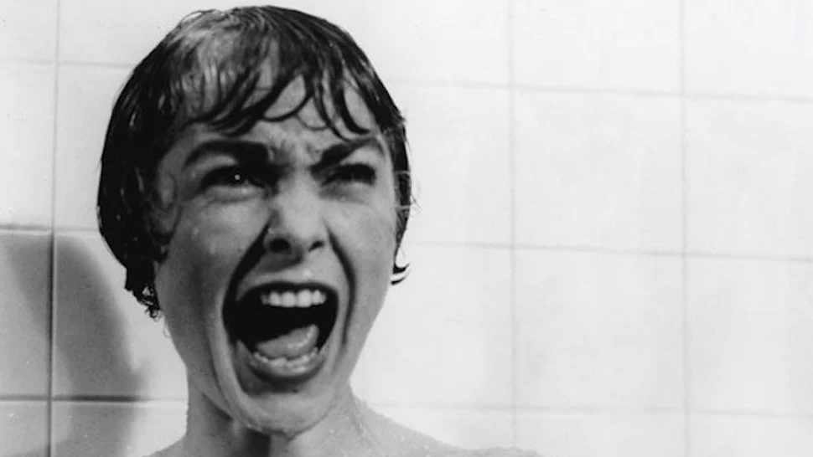
Today
We are not using “brain” data per se
User generated noise as a biosignal - which is the input into the game
Specifically → screams
Notes:
If you think about it though, our voices originated in motor movements

Slide 9
Hack Night Project 1
Single central sprite based character
Scream and it jumps
Extra Goals:
Different frequencies elicit different effects
Real-time
Sustained scream results in something
Your thoughts

Slide 10


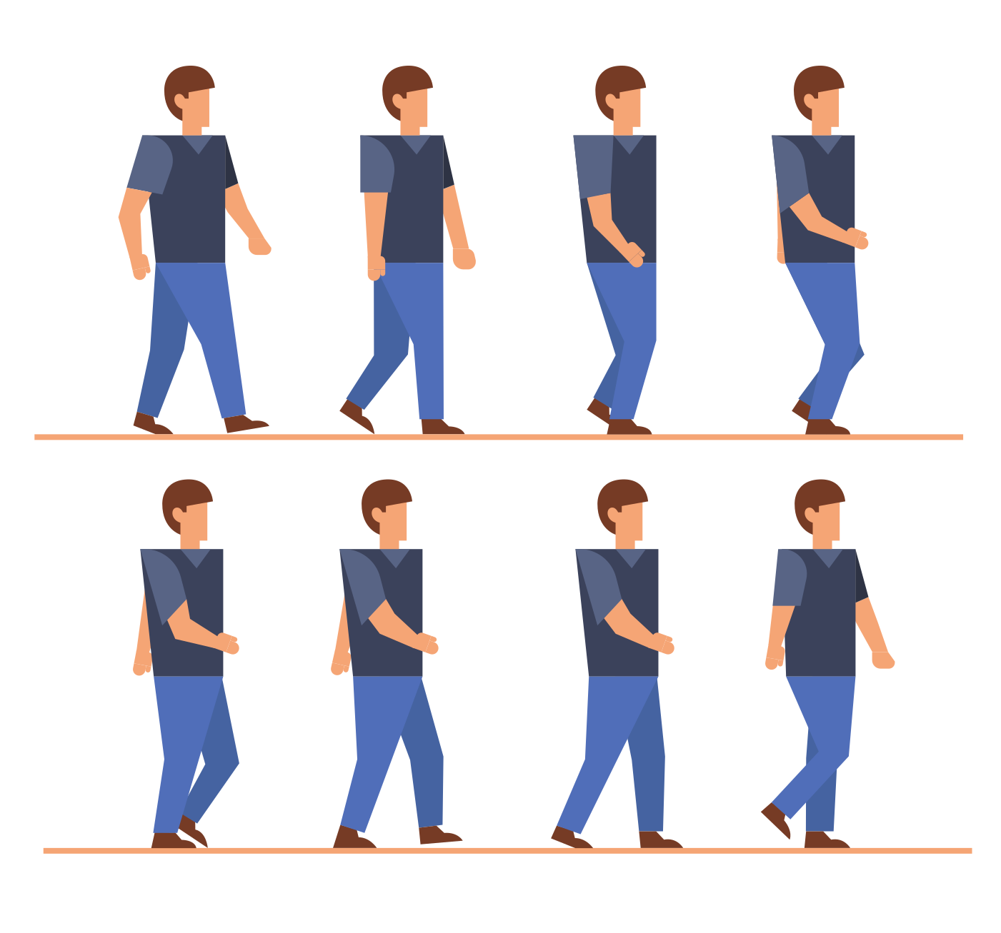
What is a sprite?
Notes:
Sprite sheet

Slide 11
Team 1 - Construct Env & Character Sprites
Plan of attack?

Slide 12
Team 2 - Signal Processing
Break down audio signal in a meaningful manner?

Slide 13

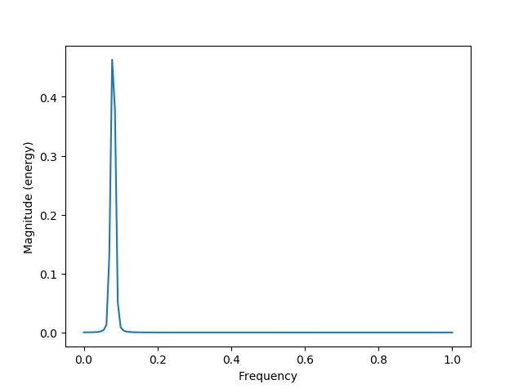
Spectra
time = np.arange(0, 65, .25);
signalAmplitude = np.sin(time)
plt.magnitude_spectrum(signalAmplitude)
plt.show()
Notes:
# Get sample points for the discrete signal(which represents a continous signal)
# The sampling frequency (samples per time unit). It is used to calculate the Fourier frequencies, freqs, in cycles per time unit. The default value is 2

Slide 14
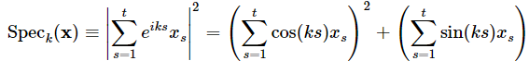
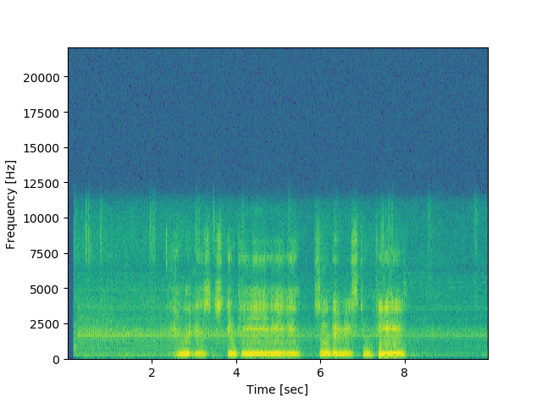
Spectragram
Notes:
A spectrogram is a visual representation of the spectrum of frequencies of a signal as it varies with time
Our spectrogram is the pointwise magnitude of the fourier transform of a segment of an audio signal.
Open Open_Wav_Spectrogramify.py

Slide 15
Team 2 - Signal Processing
Plan of attack?
Use frequencies (i.e., pitch of voice) to determine if a player jumps or not.
Potential application: training singing at a correct pitch in the form of a game
(Completed) Take in audio signal
(Completed crudely) Check if level of noise is above threshold
Simple solution: cluster means for a certain time point for the frequencies and check if one cluster is greater than another. If True, jump. Else, don’t jump.
If above or equal to threshold: 1. Elif below threshold: 0.
Final returns: a list containing 1s and 0s where 1 = jump and 0 = don’t jump
To be implemented:
Associating timepoints with whether the character jumps or not
To be implemented later: real-time processing of jumping
Real time plotting: https://www.youtube.com/watch?v=Ercd-Ip5PfQ
Notes:
Must have the right packages in your environment ready
Open Pull_Audio.py

Slide 16
Team 3 - Game Design
Where to start?
Using pygame, create a game environment
2D field from the side, a scream = jump
later versions
frequency dictates jump heights
smoother movements, more detail
implement side-to-side

Slide 17
Team 3 - Game Design
Plan of attack?
Install pygame
Brush up on environment
Add gravity
Choose sprite
Configure sprite

Slide 18
We Got the Dollar Dollar Bills
OpenBCI hardware
Help us pick what equipment we get!

